Slide 1

Hello World!
We are team Brute_force. Striving to turn ideas into reality by converting coffee into code.

Slide 2
Problem Statement
?
Automation & Space:
Open Innovation

Slide 3
38,700
Each year this many vehicle crashes due to dense thick fog

Slide 4
Overview
As the climate conditions worsen across the globe and the tandem between the
weather and its impact get destabilized, the consequences are immense for the
human race.
Fog on highways is the means to an end, the end being an accident so deadly
that it can even cost a human life.
Each year, over 38,700 vehicle crashes occur in fog. Over 600 people are killed
and more than 16,300 people are injured in these crashes annually.
And human life is too precious to lose, especially that big a number. Enter
Optic-mistic, a technology with the capability of revolutionizing driving
systems, to drive a car safely in foggy conditions.

Slide 5






ptic-Mistic
Beyond the fog lies clarity

Slide 6
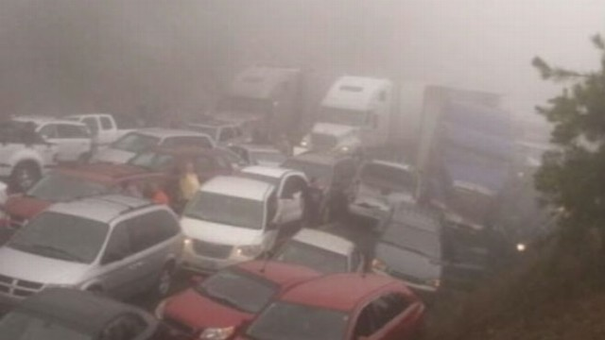
Why we chose this problem ?
On December 24,2018 8 people, including seven from the same family, were killed in a highway pile-up due to thick fog In Jhajjar, Haryana.
Five days later, on December 20,2018, 7 people were killed and 4 injured when a vehicle rammed into two due to heavy fog on the Ambala Chandigarh national highway.
This is just the tip of the iceberg. So why not invent a technology to prevent that? Which we just did.

Slide 7
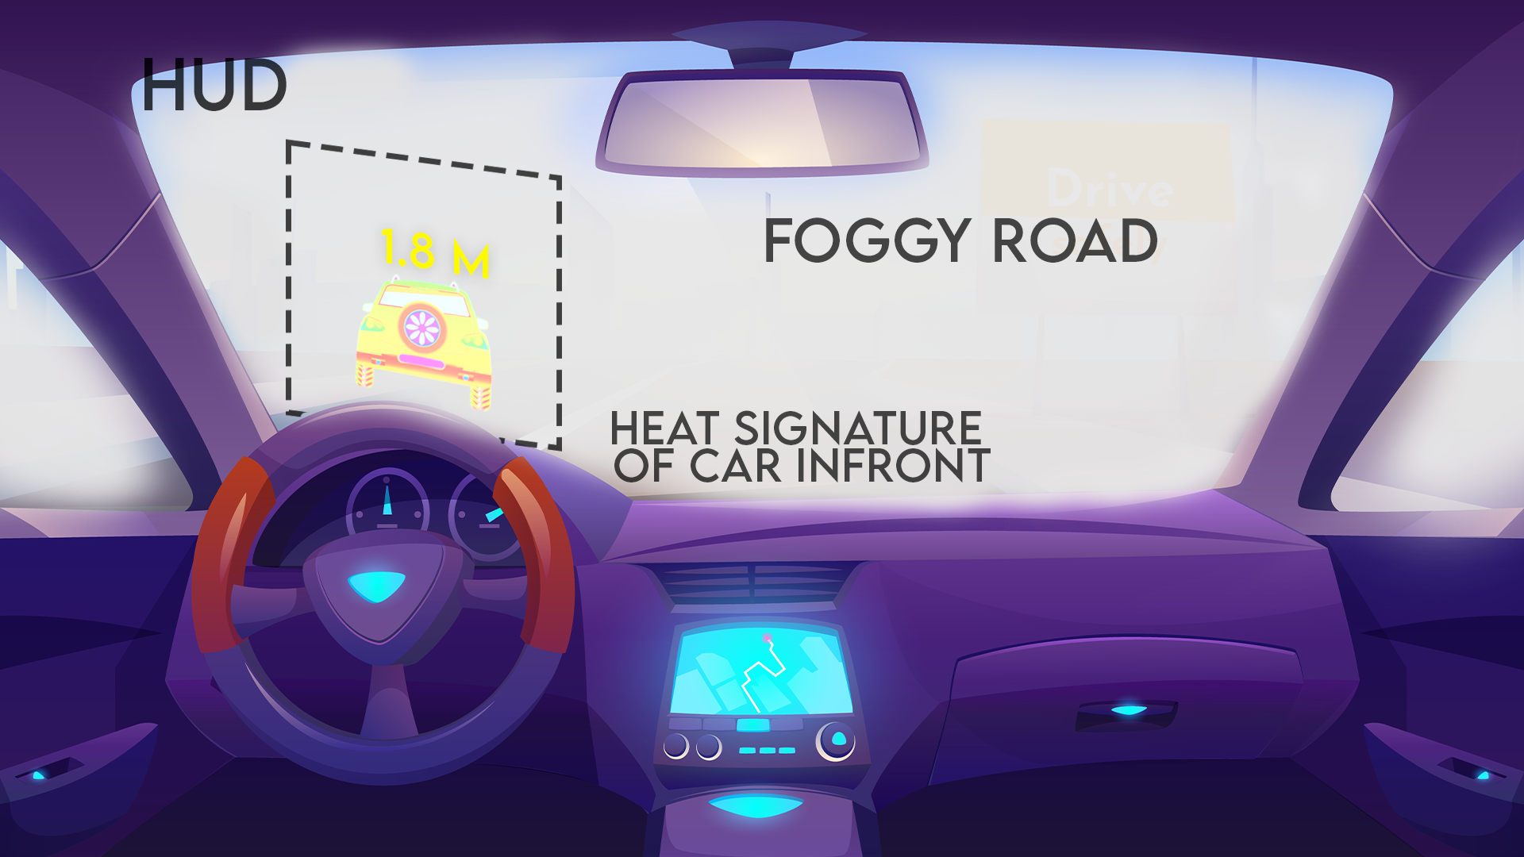
Our Intervention
We designed a technology with the capability of revolutionizing driving systems, by providing IR technology coupled with sensor-based systems, to provide an environment in order to drive a car safely in foggy conditions.
The distance between the object and the vehicle is provided to the driver so he can drive safely. Also it distance is less than the threshold amount it will automatically engage the brakes

Slide 8
Working
We installed an IR camera, which detects the heat signatures if the object in front.
Next, we even added an Ultrasonic ranging sensor which calculates the distance between our vehicle and the object in front.
This information is then given to the driver by means of a HUD.
The Head-up Display or the HUD provides users the collected data by the means of a transparent display, the windscreen, so that they do not have to look away while driving, thus ensuring concentration and safety.

Slide 9
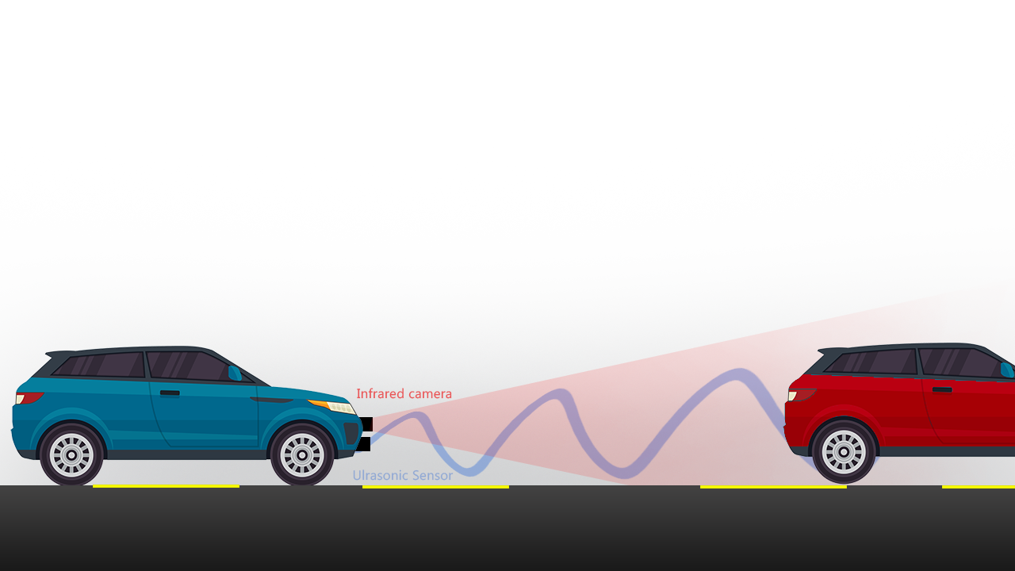
Working Continued
Infrared camera and
Ultrasonic sensor
Image processing and distance measurement in Raspberry Pi
Showing mirror image of heat signature in 11” LCD display
Pneumatic actuator
*all the visuals are made by us

Slide 10
Costing

Slide 11
Future Scope
The technology created will JUST display the image of the object in front of the vehicle on the HUD directly in front of the driver.
But as the technology gets advanced in the future, the HUD will actually show
the driver, where exactly is the object in front by means of Augmented Reality
which will enhance the experience.

Slide 12
Conclusion
In conclusion, this technology will make the driver aware of his surroundings so
that he can drive at a safe distance in foggy conditions.
This will have widespread applications and according to statistics will
significantly plummet the number of deaths by fog induced pile-up on
highways.

Slide 13
cout<<“Thank you”;
exit(1);

